Slide 1

Hormonal Influences on growth

Slide 2
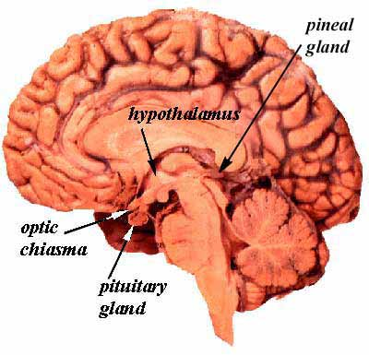
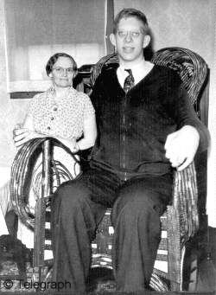
Hormonal Influences on growth
Learning Outcomes:
Pituitary hormones – the role of the pituitary gland in the control of growth and development involving human growth hormone (GH) and thyroid stimulating hormone (TSH). (The role of thyroxine).
Plant growth substances
Indole acetic acid (IAA) -site of production, effects at cellular and organ levels, role in apical dominance, leaf abscission and fruit formation.
Gibberellic acid (GA) – Effects of GA on dormancy and in dwarf varieties of plants, role of GA in α-amylase induction in barley grains.
iii) Practical applications of plant growth substances as illustrated by herbicides and rooting powders.

Slide 3
Growth hormones in Animals
Hormone | Somatotrophin (Growth hormone) | Thyroid stimulating hormone (TSH)
Produced Target | Pituitary Gland Accelerates amino acid transport to cells of soft tissue and bones. | Pituitary Gland Controls activity of thyroid gland which produces thryroxine which regulates metabolism.

Slide 4
The pituitary gland secretes human growth hormone

Slide 5
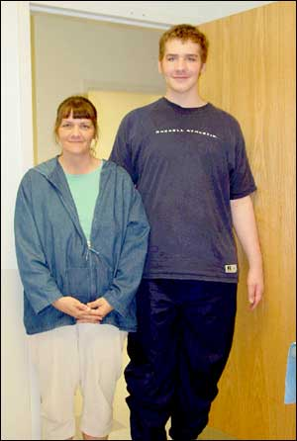

In some individuals there is an over production of human growth hormone.

Slide 6

The car had the front seat removed to allow for additional legroom.- 1939

Slide 7
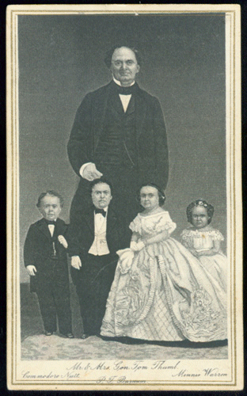
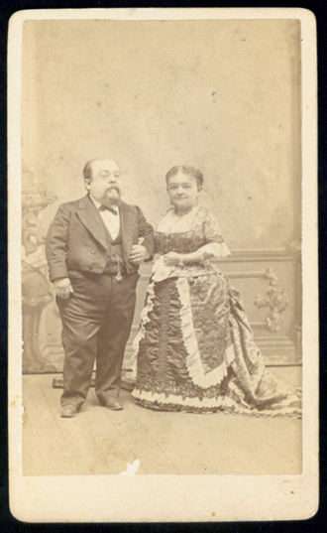
In some individuals there is an under production of human growth hormone.

Slide 8
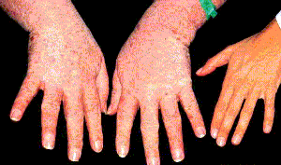
Over production of growth hormone in adulthood can lead to acromegaly – the enlargement of hand, foot and jaw bones.

Slide 9
The pituitary gland also secretes thyroid stimulating hormone (TSH)

Slide 10
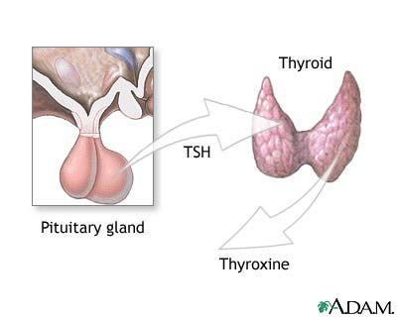
The pituitary secretes thyroid stimulating hormone (TSH), which stimulates the thyroid gland to secrete hormones that affect body metabolism.

Slide 12
Growth hormones in Plants
Auxins (ie. IAA indole acetic acid)
Produced by root and shoot tips and meristems
Moves from cell to cell by diffusion or longer distances by translocation in phloem.
Stimulates primary and secondary growth at meristems
Promotes cell elongation
Necessary for cell differentiation
Promotes formation of fruit coat
Prevents abscission layer forming (figure 30.20)

Slide 13
Experiments involving auxins

Slide 14
Effect of concentration of IAA on plant growth
% stimulation
10⁻⁵
10⁻⁴
10⁻³
10⁻²
10⁻¹
1
10
100
1000
% inhibition

Slide 15
Apical dominance
Plants apical bud present
Lateral buds are dormant
Apical bud replaced with plug of auxin
Lateral buds are dormant
Apical bud replaced plain plug – No auxin
Lateral buds grow

Slide 16
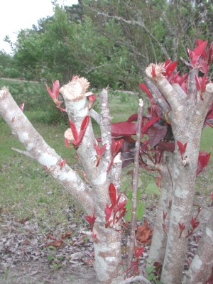
Apical dominance: inhibition of growth of side buds by auxin from apical bud. This is removed when the plant is pruned, allowing growth of new side shoots

Slide 17
Growth curvature effects
Agar with auxin at top of shoot
Growth occurs
Shoot bends

Slide 18
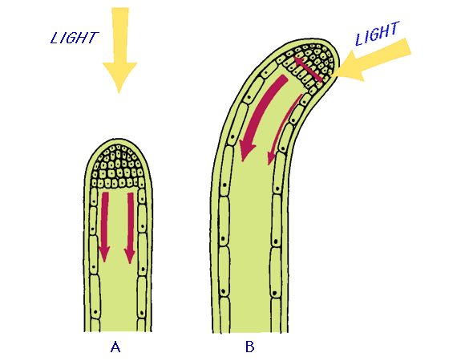
IAA and phototropism
Phototropism = directional growth movement by a plant in response to light from one direction.
Light
The shoot bends due to a higher auxin concentration on the shade side of the shoot.

Slide 19
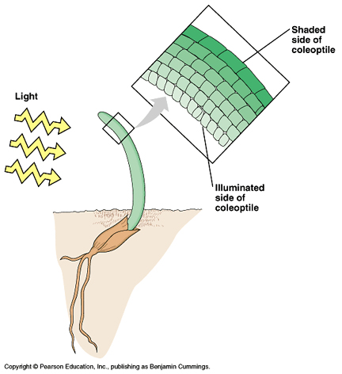
Greater auxin concentration on this side

Slide 20
Commercial applications of auxins
Parthenocarpy
Fruit development without fertilisation.
Delaying abscission of fruit
Prevents fruit dropping early before they are fully ripe.
Rooting powder
Stimulates the formation of adventitious roots for propagation.
Herbicides (selective weedkiller)
Stimulates plants metabolism – the plant exhausts its food reserves and dies of starvation. (figure 30.22)

Slide 21
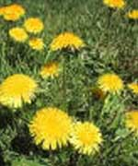
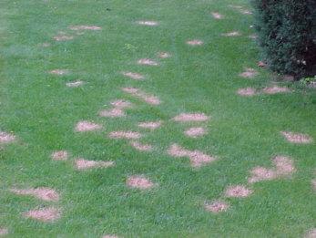
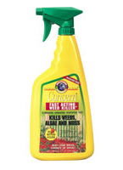
Selective weed killer (auxin)

Slide 23
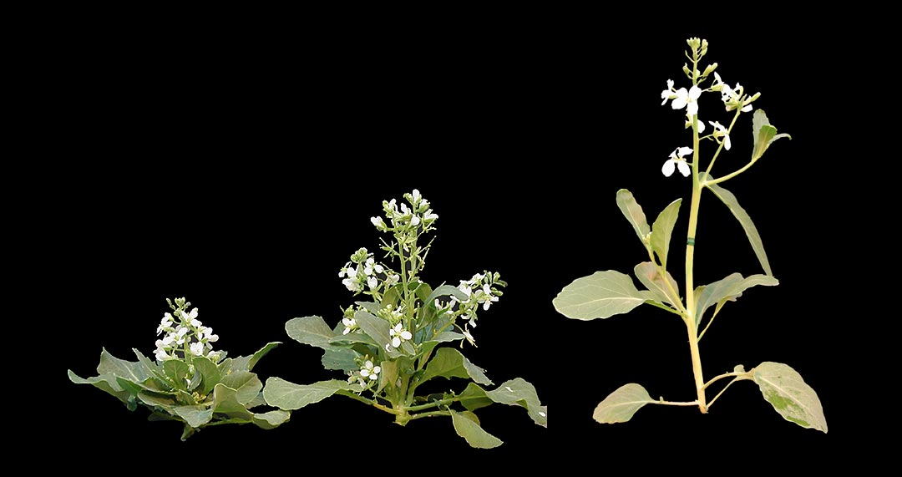
Gibberellins
ie. Gibberellic acid (GA)
Stimulate cell division and elongation of stems
Experiments involving Gibberellins
Effect of GA on dwarf pea seeds
GA increases the length of internodes (not the number of internodes) to overcome genetic dwarfism (fig. 30.24)

Slide 24
Effect on germinating barley grains
GA breaks dormancy of seeds
Aleurone layer
Gibberellin is made by the embryo.
Passed to the aleurone layer.
Induces the production of α amylase.
α amylase digests starch into maltose (sugar) allowing plant growth.
starch
α amylase
sugar
gibberellin
embryo

Slide 25
The Effect of GA on bud dormancy (fig 30.28)
Bud coated with lanolin containing GA
Breaks dormancy of buds.
GA is produced naturally by plants in spring to break bud dormancy.
Can by applied artificially to break dormancy early.
Winter bud opens
Bud coated with plain lanolin
Winter bud remains closed

Slide 26
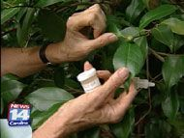
The use of gibberellic acid by camellia growers is a popular practice in the United States.
Camellia flower buds can be forced into blooming early following treatment with gibberellic acid in late summer or early fall.

